Slide 1
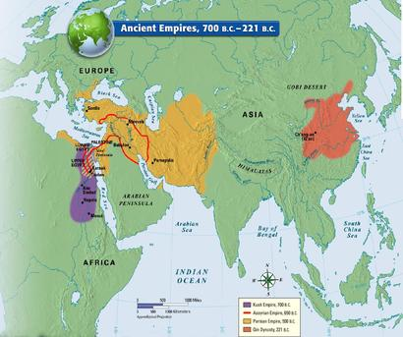
The First Empires

Slide 2
Development of Empires
By 1000 B.C.E empires were being shaped by drought, famine, migrations, technological and political advancements
Political leaders centralized their power
Political, military, religious and economic systems were unified under one ruler
Linked peoples of different regions with a common language and economic system

Slide 3
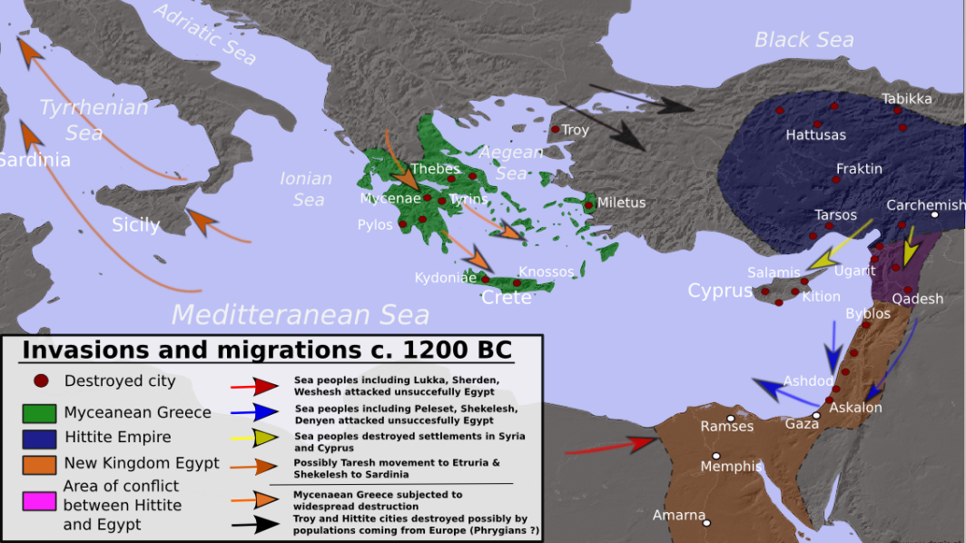
The Collapse of City-States
About 1200 B.C.E. Afro – Eurasia was hit by drought and famine
Migrations led to political turmoil and the collapse of city – states
Migrations led to a disruption in the trade routes of the Near East

Slide 4
The Assyrians
Early Assyrian kings were semi nomadic pastoral rulers
Centered on the Tigris River in upper Mesopotamia
Came under the rule of Sargon the Great of Akkad around 2334 B.C.E.
Ashur was established as an early Akkadian outpost
Came under control of successive kingdoms

Slide 5
The Assyrians
Became an Akkadian trade center as it lay on major regional trade routes
Prospered due to trade
Became an independent city-state around 2154 B.C.E.
The populace began to worship the god Ashur around 2100 B.C.E.
Paid tribute to the city of Ur

Slide 6
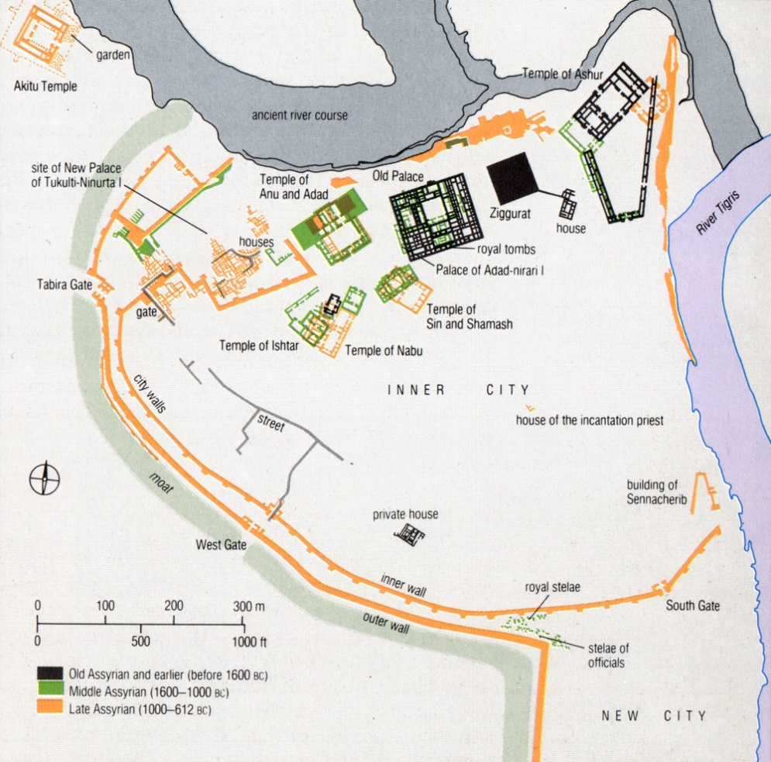
The City of Ashur
Established around 2200 B.C.E. as an outpost
Flourished as the Assyrians expanded their control and influence
Conquered by the Hittites around 1680 B.C.E.
King Shamashi Adad I secured the borders of Assyria during his reign of 1813 to 1791 B.C.E.

Slide 7
The Rise of Assyria
Conquered by the Babylonians under Hammurabi around 1791 B.C.E.
Periods of independence and subjected state followed for the next 450 years
Regained independence around 1400 B.C.E.
Expanded control and influence by conquering former ruling states, including the Hittites
Consolidation of power by 1100 B.C.E.

Slide 8
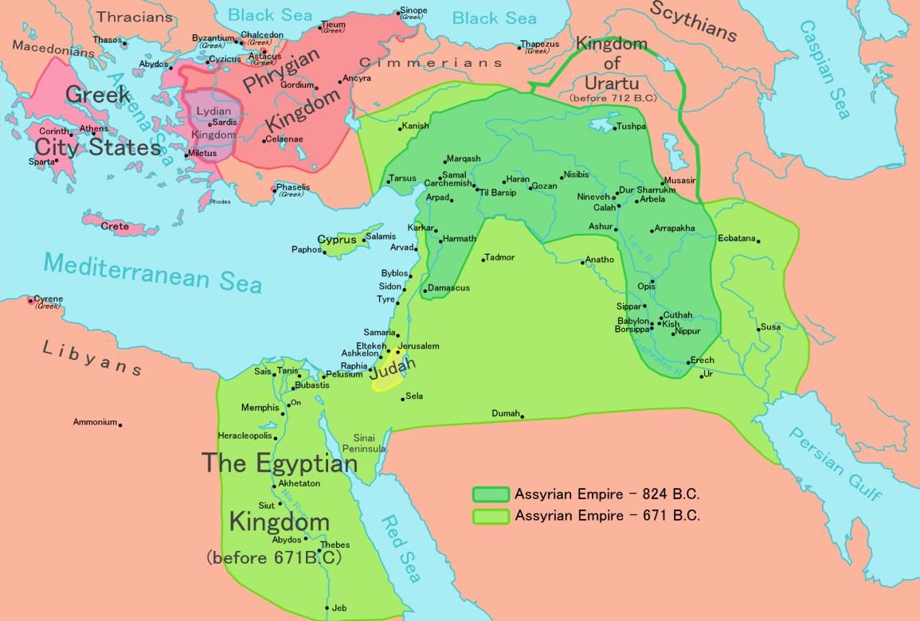
Assyrian Empire
Around 912 B.C.E. King Adad Nirari II secured the Assyrian borders
Those who opposed the state were enslaved or deported
Established outpost and road system
Forced subjected peoples to pay tribute

Slide 9
Rule of the Assyrians
Divided the empire in to two parts with a governor for each part
Subjected rulers were to supply manpower and gold and silver
Forced labor included serving in the military
Established their capital at Nineveh around 880 B.C.E.
Built large temples and palaces in Nineveh

Slide 10
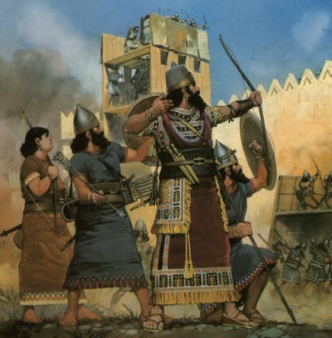
The Assyrian Army
Consisted of cavalry, infantry, chariots, siege towers and rams
Well disciplined and trained and armed with iron weapons
Led by officers promoted on merit
Contained nearly 100,000 men at its peak

Slide 11
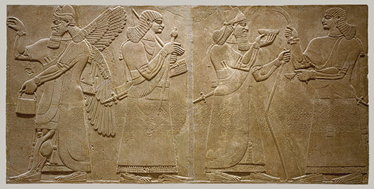
Assyrian Society
Rulers promoted a rigid social hierarchy
Military elites were rewarded with land, gold and tax exemption
Commoners were subject to rule by the king and local elites
Many commoners were enslaved due to debt

Slide 12
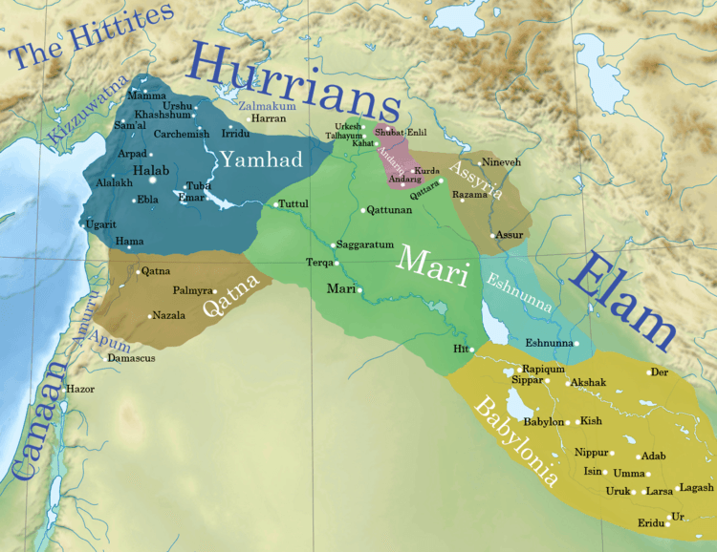
Assyrian Government
Central power was held by the king
The king was viewed as the messenger of Ashur
Specialized ministers presided over branches of the government
Governors were appointed to oversee provinces

Slide 13
Assyrian Government
Preferred to rule distant states as “client states”
Began a policy of deportation of subjugated people around 1250 B.C.E. after victory over the Hittites and Mitanni to reduce rebellions
Individuals were sent where their skills could best serve the state
Replaced deported people with Assyrians
Regardless of origins, capable individuals were able to rise through the bureaucratic ranks

Slide 14
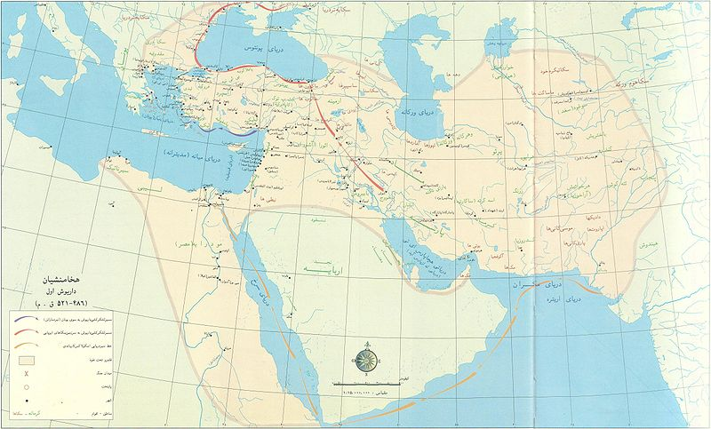
The Achaemenids
Migrated from the central plains of Asia around 2000 B.C.E.
By 1000 B.C.E Aryan groups such as the Medes and Persians had established themselves across the Iranian Plateau
In 612 B.C.E. the Medes assisted the Babylonians in the defeat of the Assyrians
Persians emerged as dominate Aryan group around 550 B.C.E.

Slide 15
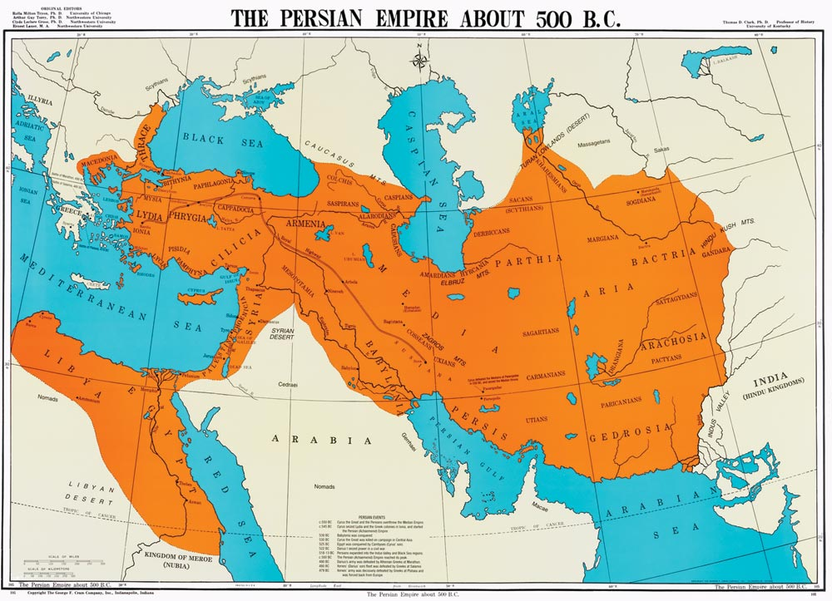
The Persian Empire
Cyrus the Great united the tribes in 559 B.C.E.
King was absolute ruler
Conquered Babylonia in 539 B.C.E.
Conquered Egypt in 525 B.C.E.
Relied on local rulers to implement Persian laws

Slide 16
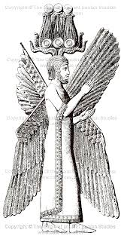
Cyrus the Great
Reigned from 559 to 530 B.C.E.
Respected the customs and religions of the conquered peoples
Established a government for the benefit of its subjects
Played a key role in the identity of modern-day Iran

Slide 17
Cyrus the Great
Recognized for his advancements in human rights, politics and military strategy
Established a centralized government
Following the conquest of Babylon in October 539 B.C.E. issued the Edict of Restoration freeing the Jews held as slaves by the Babylonians
Died in battle in 530 B.C.E.

Slide 18
The Persian Empire
Established a postal system, an economy based on gold and silver and a tax system
Established stability in the region
Rulers justified their right to rule through religion and acted as the high priest
Allowed conquered peoples to maintain their religion and customs

Slide 19
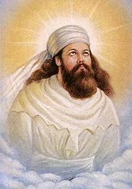
Zoroasterism
Founded by Zoroastrian, a prophet and reformer
Called for moral reform throughout all levels of Persian society
Called for the worship of only one god , the “Wise Lord”
This religion influenced ideas associated with the Jewish, Christian and Islamic religions

